Slide 1

Customer Churn Prediction in the Telecom Sector Using CRISP-DM Methodology Team Members: Akash Nikam (20054691) Himanshu Dubey (20027763)

Slide 2

Outline
CRISP-DM Methodology
Business Understanding
Data Understanding
Data Preparation
Modelling
Evaluation
Deployment
References

Slide 3
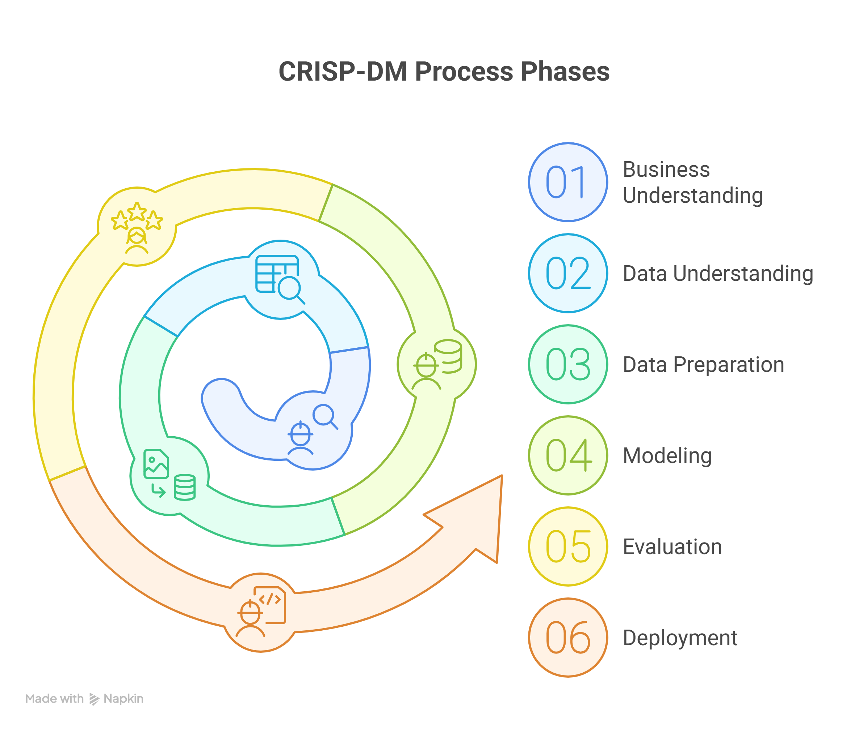
CRISP–DM
Industry-standard data mining framework
6 main phases:
Business Understanding
Data Understanding
Data Preparation
Modelling
Evaluation
Deployment
Focused on structured, repeatable analytics
Ensures project aligns with business goals

Slide 4
Business Understanding
Churn = Customers leaving the service
Telecom churn leads to revenue loss
Cheaper to retain than acquire customers
Business Goal: Predict churn early
Data Mining Goal: Build a classifier using features like:
Tenure, Contract, Monthly Charges, etc.

Slide 5
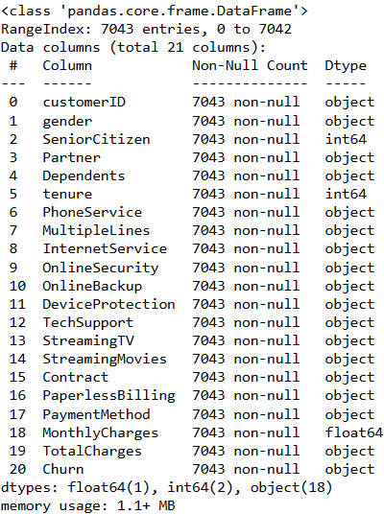
Data Understanding
Dataset shape: 7,043 rows × 21 columns
Target variable: Churn (Yes/No)
Categorical & numerical mix
Class imbalance: ~26% churned
Initial churn insights:
Higher churn for Month-to-month contracts
Fiber Optic users
Inactive members

Slide 6
Data Preparation
Removed: customerID (non-predictive)
Binary encoding: Gender, Partner, etc.
One-hot encoding: Contract, InternetService
Feature scaling with StandardScaler
Class imbalance handled using SMOTE
Final dataset: Clean, encoded, scaled, balanced

Slide 7
SMOTE Analysis & Impact
Explain
Explain the class imbalance issue (~26% churners before SMOTE).
Describe
Describe how SMOTE balanced the training dataset to 50:50.
Show
Show before/after counts for churn vs non-churn in training set.
Mention
Mention why SMOTE helps recall for churn detection.

Slide 8
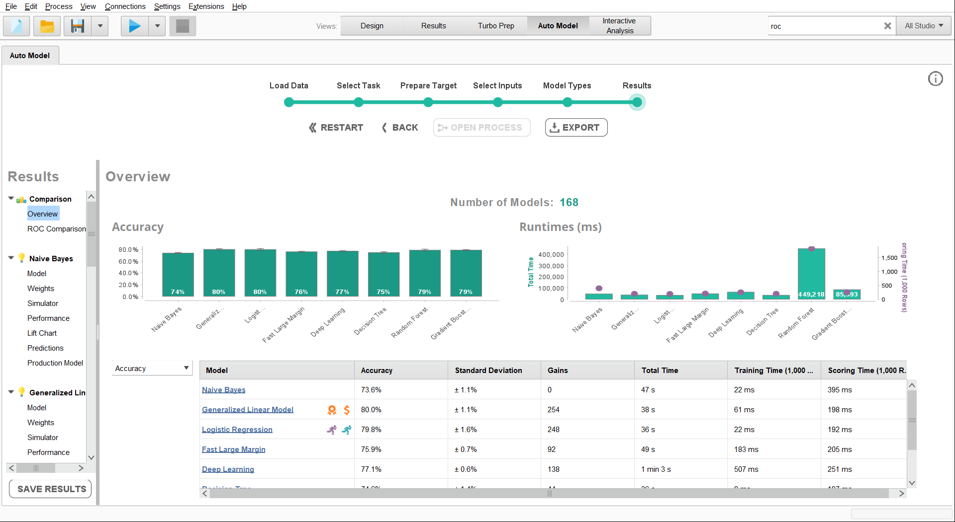
Modelling – RapidMiner (AutoModel)
Optimized via AutoModel with 5-fold CV
Metric prioritized: Recall
Best performer: XGBoost
Model | Accuracy | Recall
Logistic Regression | 81.1% | 0.99
Decision Tree | 81.8% | 0.93
Random Forest | 82.0% | 0.92
XGBoost | 86.6% | 0.97

Slide 9
Feature Insights – RapidMiner
Top churn predictors:
Contract: Month-to-month
InternetService: Fiber Optic
Paperless Billing: Yes
AutoModel visualizations:
Feature weights
Deep Learning simulator
Explainable and business-friendly

Slide 10
Modelling – Python
Model | Accuracy | Recall
Logistic Regression | 74% | 0.64
Decision Tree | 75% | 0.81
Random Forest | 77% | 0.65
XGBoost | 76% | 0.67
Full control over tuning & workflow
Higher precision, but lower recall than RapidMiner
XGBoost again top performer

Slide 11
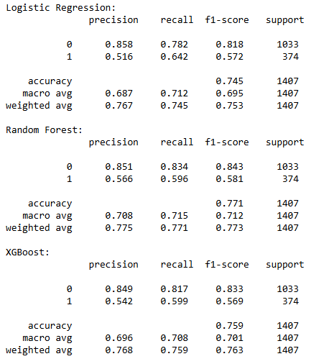
Python Results (Post-SMOTE)

Slide 12
Python Results
Confusion matrices: Model performance comparison
ROC curves: AUC between 0.81–0.84
Feature importance:
Monthly Charges
Tenure
Contract type

Slide 13
Evaluation – Comparison
Platform | Model | Accuracy | Precision | Recall | F1-score
Python | Logistic Regression | 0.74 | 0.68 | 0.64 | 0.81
Python | Random Forest | 0.77 | 0.71 | 0.65 | 0.85
Python | XGBoost | 0.76 | 0.70 | 0.67 | 0.87
RapidMiner | Logistic Regression | 0.85 | 0.86 | 0.79 | 0.82
RapidMiner | Random Forest | 0.88 | 0.89 | 0.84 | 0.86
RapidMiner | Deep Learning | 0.90 | 0.91 | 0.86 | 0.88

Slide 14

AutoModel Performance
Visual comparison of all model metrics
XGBoost leads across Accuracy, Recall, F1
Deep Learning also strong
Logistic Regression → perfect recall (but lower precision)

Slide 15
Python Model Performance
ROC curves and Confusion Matrices
XGBoost again had best AUC
Logistic Regression more conservative
Ensemble models performed better

Slide 16
Key Features Impact – XGBoost (Post-SMOTE)
Top Predictive Features (XGBoost – Python, Post-SMOTE)
MonthlyCharges – Higher charges strongly linked with churn risk.
Tenure – Shorter tenure increases churn likelihood.
Contract Type – Month-to-month contracts correlate with higher churn.
TotalCharges – Lower cumulative spend often tied to recent customers with higher churn tendency.
InternetService – Fiber optic users churn more compared to DSL customers.
Insights:
Price sensitivity and contract flexibility remain the main churn drivers.
Customer loyalty improves significantly after the first year.
Targeted discounts or upgrades for short-tenure, high-charge customers could reduce churn.

Slide 17
Deployment Plan
Use case: Weekly churn scoring via CRM
Actions:
High-risk flagged → Retention team
Personalized outreach & offers
Model deployed in batch or API
Monitor model recall over time

Slide 18

Future Scope
Add behavioral and app usage features
Integrate SHAP for explainability
Real-time scoring using cloud (Azure, AWS)
Regular retraining with feedback loop
Scalable deployment to business pipeline

Slide 19
Thank You

